Slide 1
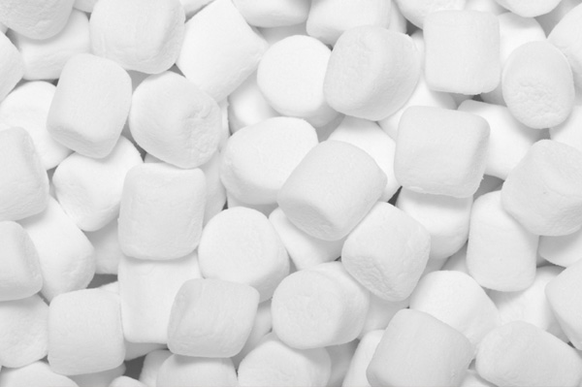
Team Competition
Marshmallow Challenge
✦ Build the Tallest Freestanding Structure: The winning team is the one that has the tallest structure measured from the table top surface to the top of the marshmallow. That means the structure cannot be suspended from a higher structure, like a chair, ceiling or chandelier.
✦ The Entire Marshmallow Must be on Top: The entire marshmallow needs to be on the top of the structure. Cutting or eating part of the marshmallow disqualifies the team.
✦ Use as Much or as Little of the Kit: The team can use as many or as few of the 20 spaghetti sticks, as much or as little of the string or tape. The team cannot use the paper bag as part of their structure.
✦ Break up the Spaghetti, String or Tape: Teams are free to break the spaghetti, cut up the tape and string to create new structures.
✦ The Challenge Lasts 15 minutes: Teams cannot hold on to the structure when the time runs out. Those touching or supporting the structure at the end of the exercise will be disqualified.
www.marshmallowchallenge.com

Slide 2
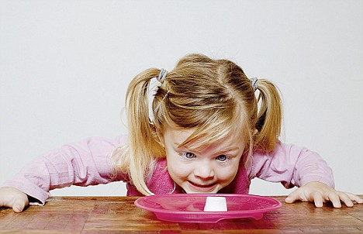
Marshmallow Challenge
Reflection Questions
What were the benefits in performing this exercise as a team? What were some challenges?
How did you determine who would do what task? Did members choose tasks that were suitable to their strengths?
If given the chance to go through this competition again, what might you have done differently?

Slide 3
Key Lessons
Marshmallow Challenge
✦ Kids do better than Business Students – Kindergarteners create taller and more interesting structures
Why?
✦ They spend more time playing and prototyping. They naturally start with the marshmallow and stick in the sticks
✦ Business Students spent a vast amount of time on planning, then executing on the plan with almost no time to fix the design. They also waste time jockeying for power – whereas the Kindergartners have no desire to become CFO of Spaghetti Inc!
Google: The Marshmallow Challenge – Video Ted 2010 Talk
Notes:
Add slide Skill Development and Evaluation

